Slide 1
Capstone Project - Battle of Neighbourhoods (Week 1) BY: Mustafa Mahmoud
Selecting the best location to open a Middle Eastern Restaurant IN Manhattan, New York

Slide 2
Introduction/Business Problem
The City of New York is famous for its excellent cuisine. Its food culture includes an array of international cuisines influenced by the city's immigrant history.
Starting a Middle eastern restaurant can be a great business opportunity, but selecting the right place can be crucial for the business to successes
Middle Eastern Restaurants are very popular and a good choice

Slide 3
Business Problem
My client wants to open his business in Manhattan area, We define potential neighborhoods based on the number of Middle Eastern Restaurant which are operating right in each neighborhood. Manhattan has full potential but also is a very challenging district to open a business because of high competition.
Based on the analysis will try to select the best place to open the restaurant

Slide 4
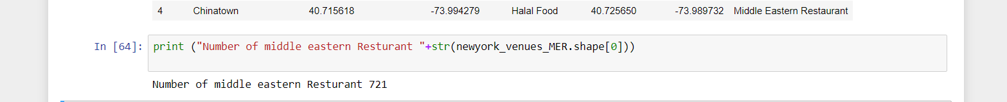
Data Selection
To identify the characteristics of our competitors' venues in Manhattan, we would first need to find out the number of Middle eastern Restaurant in Manhattan currently and their locations.
We then used FourSquare API to find their geographic coordinates based on their postal code addresses.
In Manhattan, there are 721 Restaurants are currently operating.

Slide 5
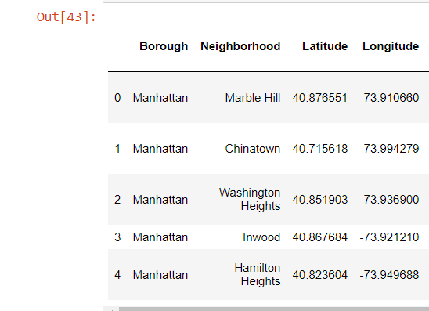
Data Selection
Next, we also used FourSquare API
to find their geographic coordinates of the 5 locations shortlisted for our MER Resturant:
Table 2: Data frame containing geographic coordinates of our 5 shortlisted locations

Slide 6
Methodology
Addresses are converted into their equivalent latitude and longitude values.
Foursquare API is used to explore neighborhoods in Manhattan, New York.
After that, explore function to get MER restaurant categories in each neighborhood.

Slide 7
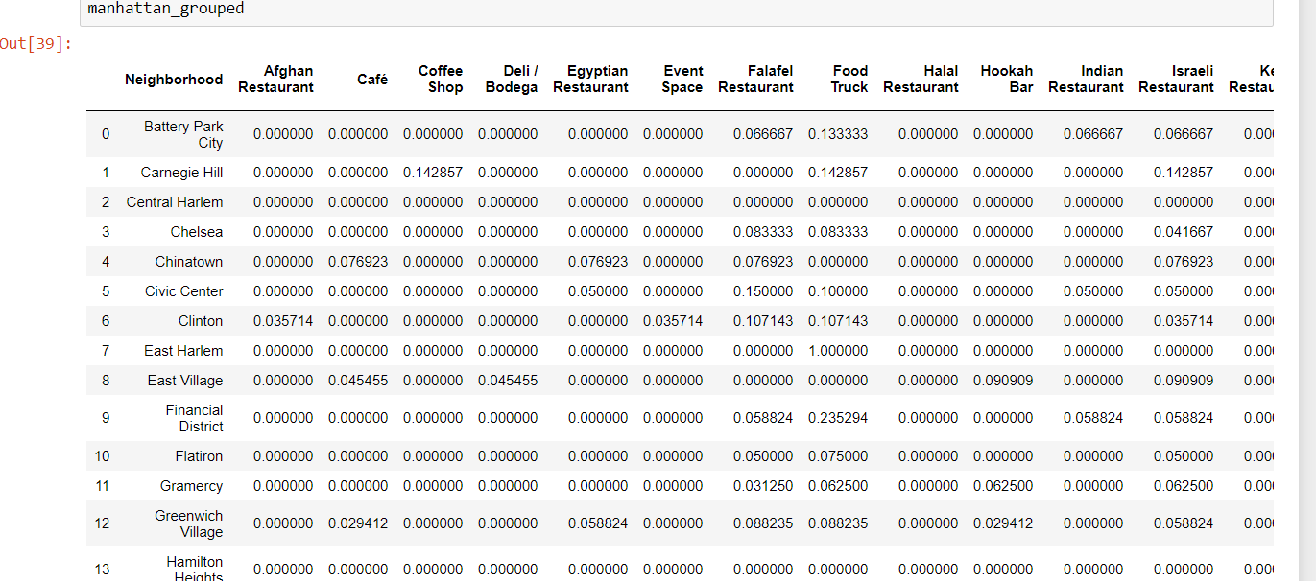
Methodology -Cont’d

Slide 8
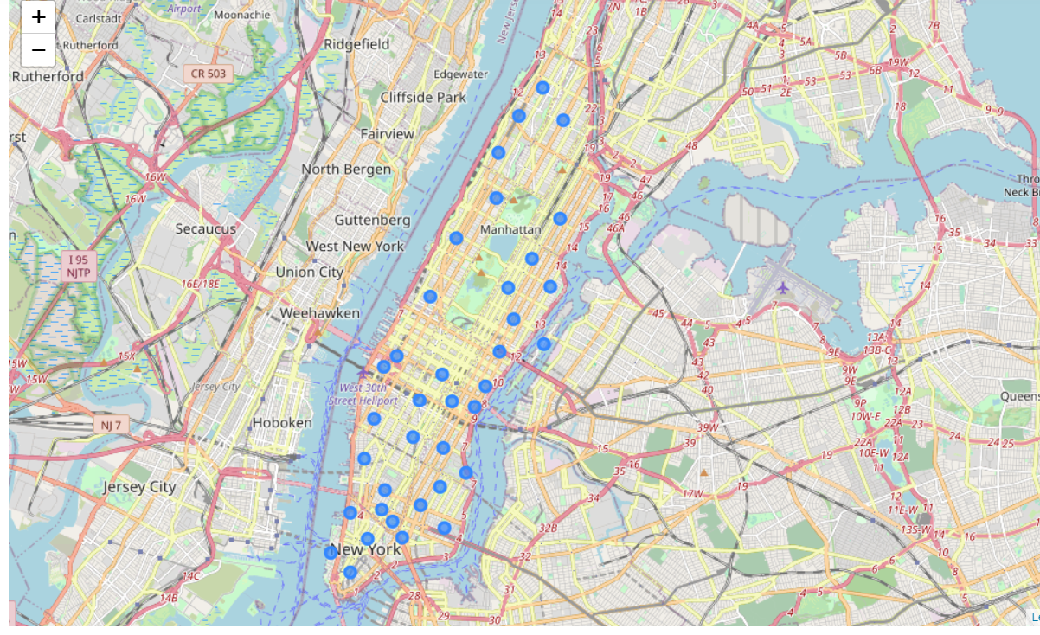
Methodology –Cont’d
Middle eastern Resturant in Manhattan

Slide 9
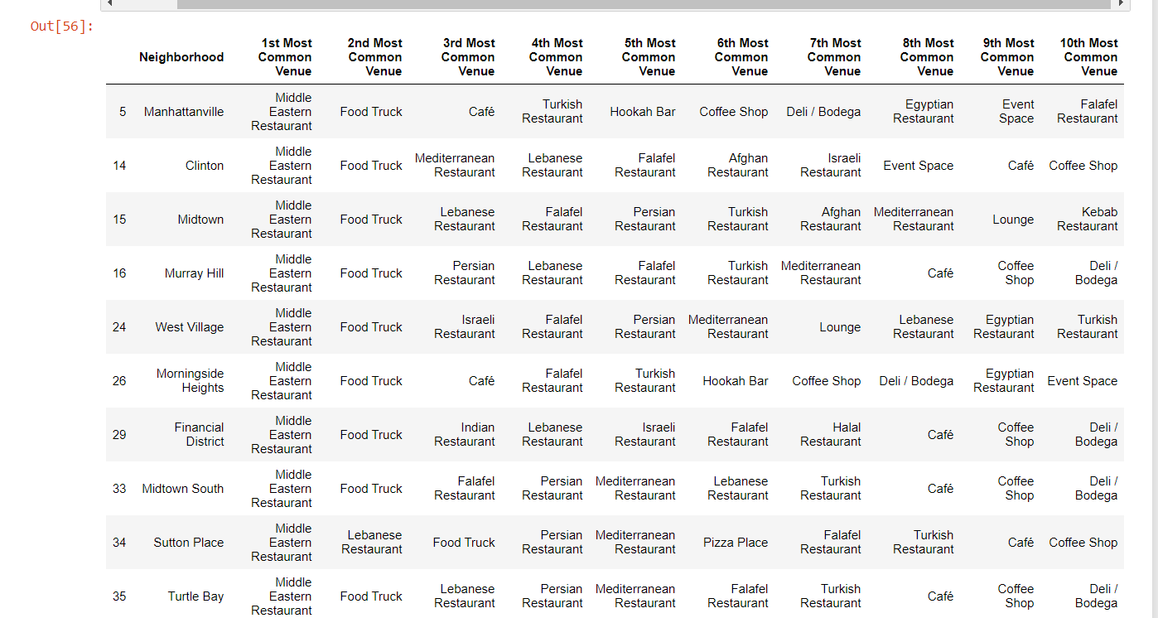
Methodology Cont’d
Then by using this feature to group the neighborhoods into clusters K-means clustering algorithm will be use to complete this task. And also, the Folium library to visualize the neighborhoods in Manhattan and its emerging clusters.

Slide 10
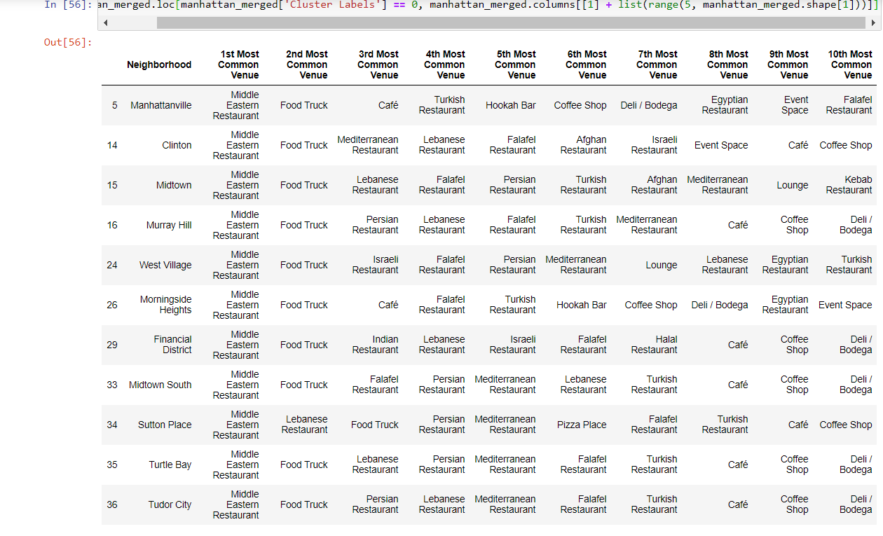
Results
Using K-mean to clustering data area with less number of sushi bars
Cluster 0

Slide 11
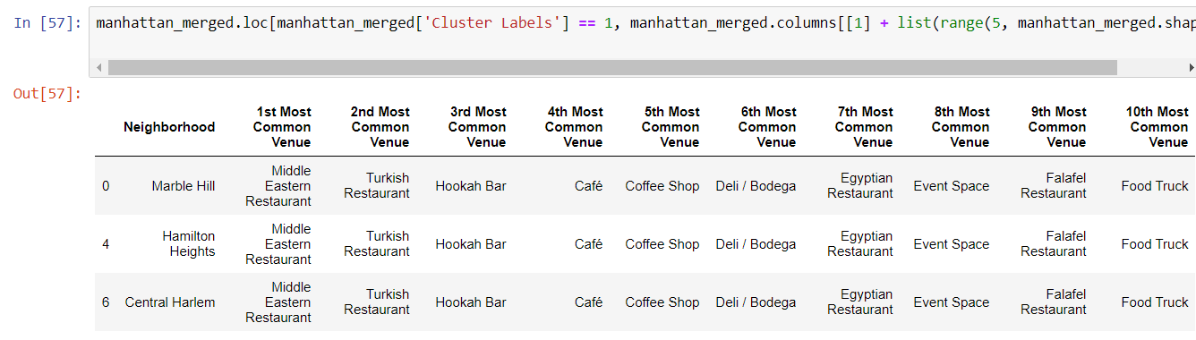
Result Cluster 1

Slide 12
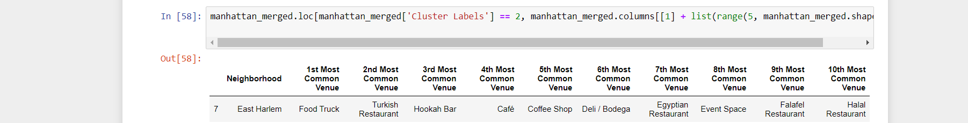
Result Cluster 2

Slide 13
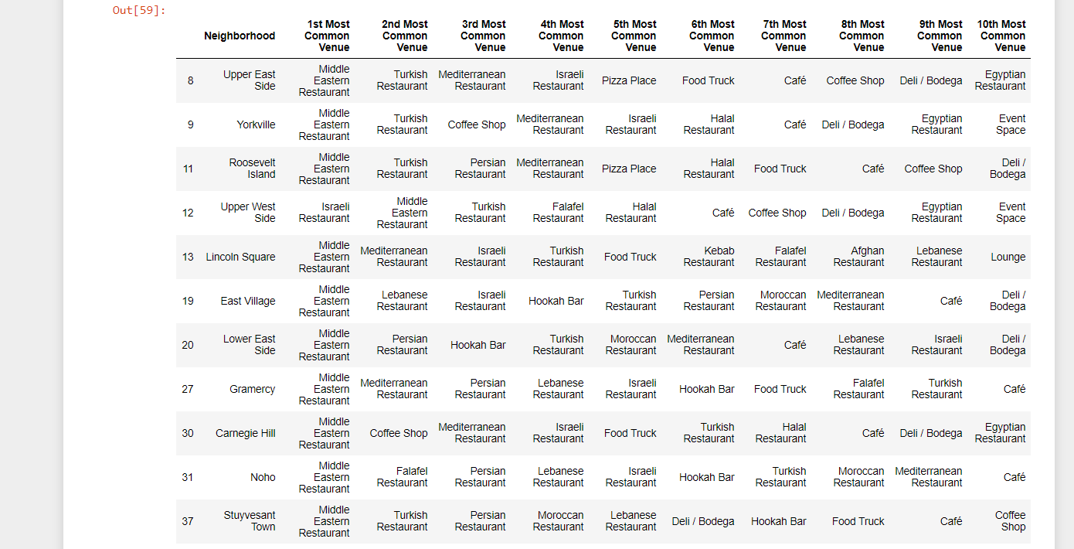
Result-Cluster 3

Slide 14
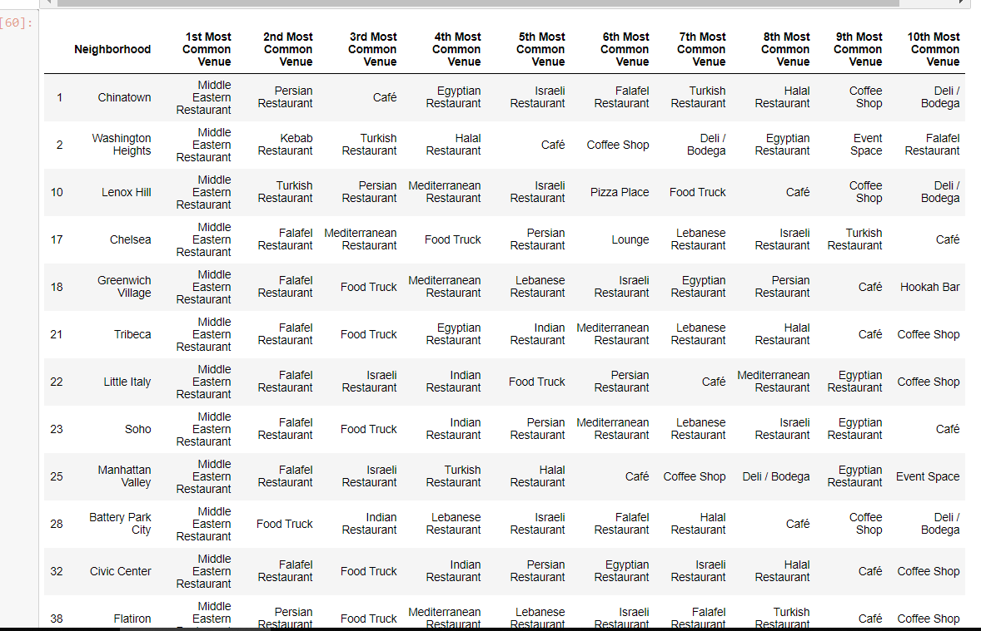
Result Cluster 4

Slide 15
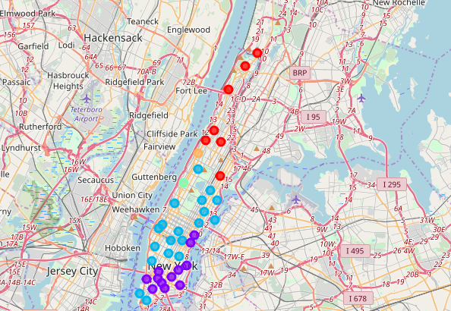
Result

Slide 16
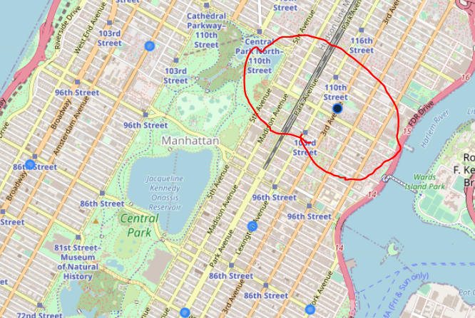
Result
Based on analysis above Cluster 2 (East Harlem) areas is the best place to open a new Middle Eastern Restaurant.

Slide 17
Discussion
This analysis is performed on limited data. This may be right or may be wrong. But if good amount of data is available there is chance to come up with better/different results.
There is high competition in Manhattanville, and Clinton so it is very risky to open business in these areas.
It can be done more detailed analysis by adding other factors such as transportation, demographics of inhabitants.

Slide 18
Conclusion
Although all of the goals of this project were met there is definitely room for further improvement and development as noted below. However, the goals of the project were met and, with some more work, could easily be developed into a fully pledged application that could support the opening a business idea in an unknown location.

